Slide 1

Restoring peace in Peaceland
A scalable Big Data project to help citizen to find harmony

Slide 2
Problematics
What technical constraints must the architecture meet? Which components should be used?
What business constraints must the architecture satisfy? Which components should be used?
How to explain the failed attempt?
What information should be added to the drone report to meet future needs?

Slide 3
1. Technical constraints
Large amount of data to store: 73 Tb/year
Quick access to this data (especially for alerts)
Different types of data

Slide 4
2. Business constraints
Ability to assign alerts to the nearest available PeaceMakers
Adapt alert threshold according to the number of available PeaceMakers
Reduce costs
Use streams to fluidify data processing
Web UI for PeaceMakers

Slide 5
3. Failed attempt
Lack of precision on business & technical constraints
Probably a not scalable solution

Slide 6
4. Improvements
Study PeaceScore evolution to better target & prevent interventions
Evaluate PeaceScore with other observations : social networks comments, ... etc.

Slide 7
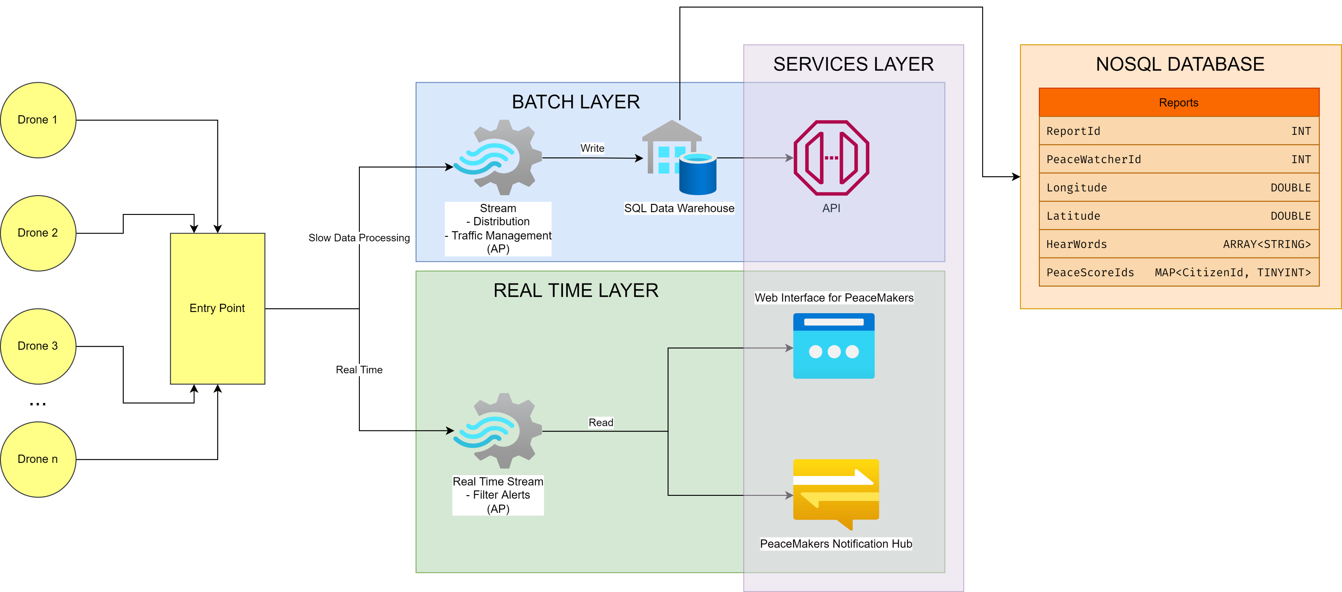
5. Proposed architecture

